Slide 1
Neural network interpretability

Slide 2
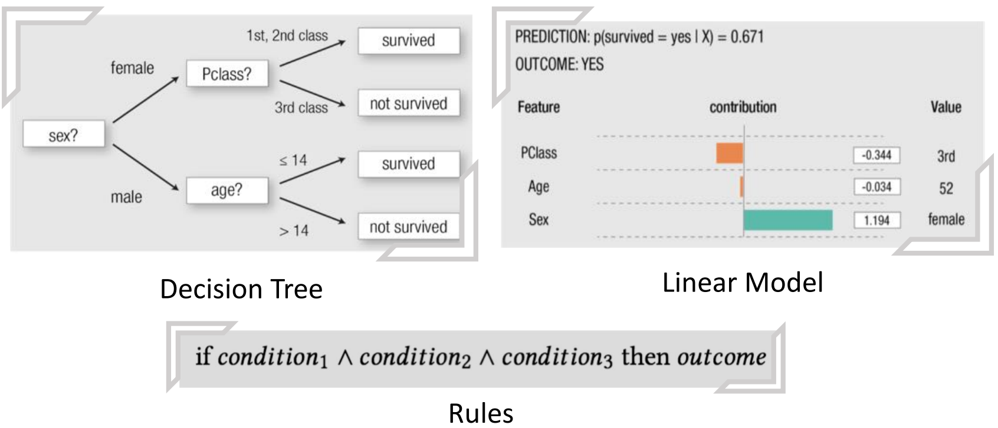
Interpretable vs. Uninterpretable
Interpretable Examples
decision tree, linear model, rules, etc.

Slide 3
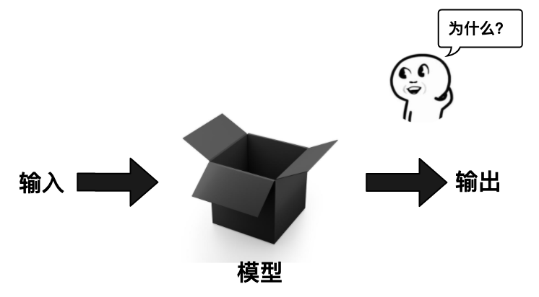
Interpretable vs. Uninterpretable
The empirical success of DNNs raises many unsolved questions to theoreticians
What are the merits (or inductive bias) of DNN architectures ? What are the properties of DNNs’ loss surface/critical points ? Why DNNs generalizes so well with just simple regularization ? What about DNNs’ robustness/stability?

Slide 4
Outline
Why we need interpretability?
Types of interpretability
How to evaluate interpretability?
Interpretability Methods for DNN

Slide 5
Why we need interpretability?

Slide 6
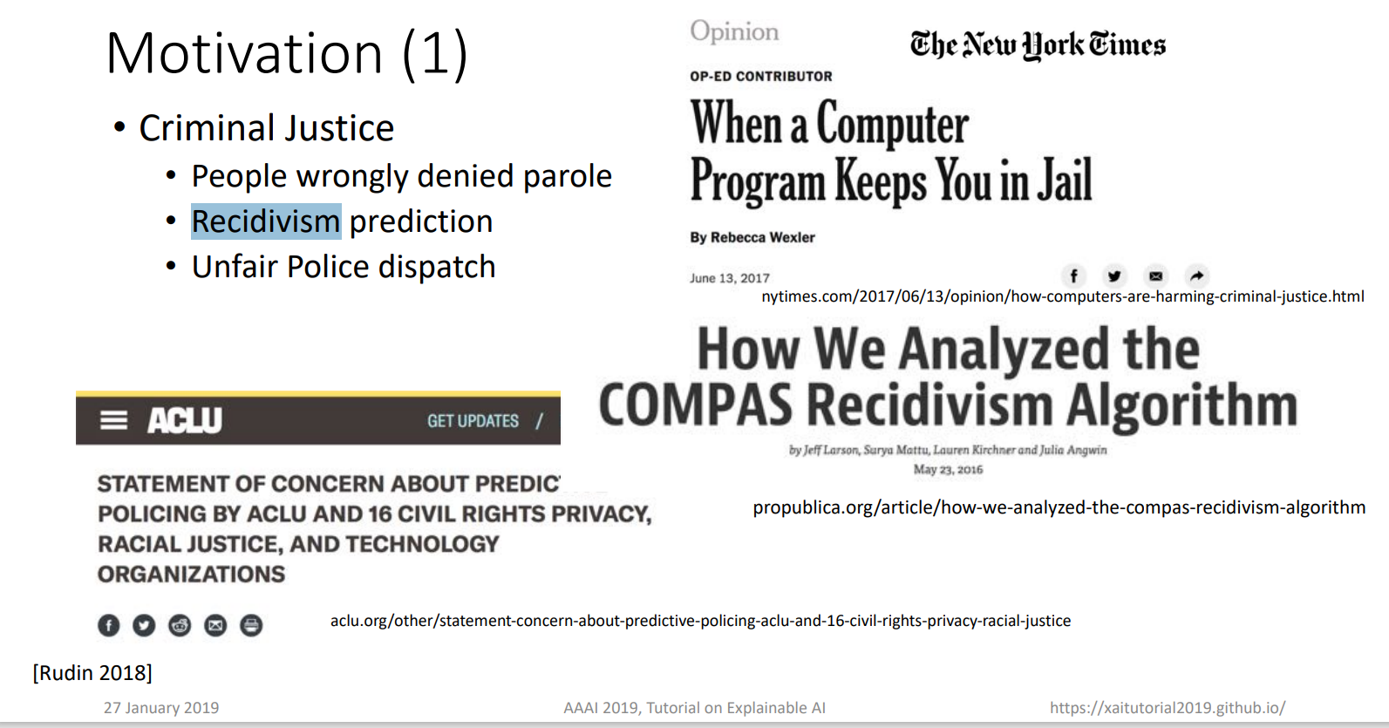

Slide 7


Slide 8
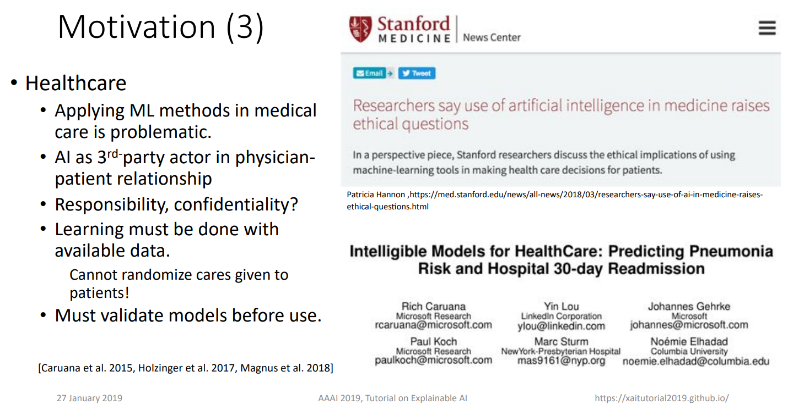

Slide 9
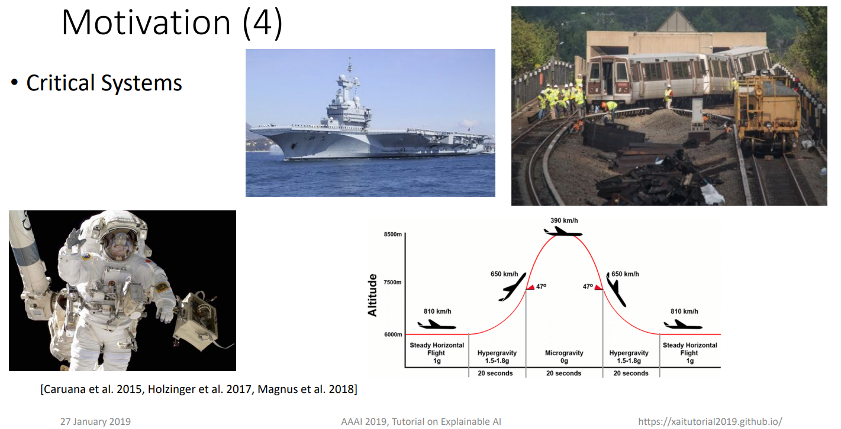

Slide 10
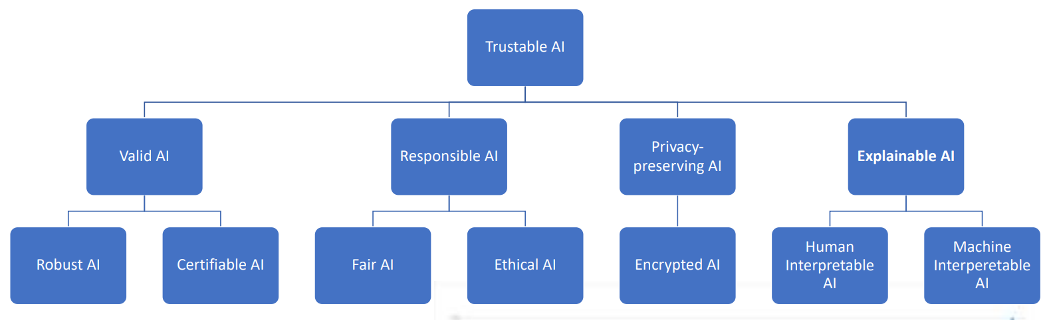
AI for Future

Slide 11
More Reasons
1. When the in-depth learning model undertakes tasks related to human personal safety, such as automatic driving, medical imaging, etc., if people cannot know what the in-depth model is based on to make decisions, even if the model is very effective, it may still cause serious security concerns and ethical and legal disputes, and a good explanatory nature will greatly increase the social recognition of the model.
2. The debugging of model performance may require interpretable participation. For example, the recommendation system often does not have a clear loss function as a measure, but if we can know what the model is pushed based on, we can know whether the model is effective.
3. Exploration of knowledge itself. For black box models such as neural networks, some problems may be solved well by modifying super parameters, but the internal mechanism of the model and the dependence of parameters are still unknown. Therefore, it is very valuable to explain the model whether from the perspective of exploring the generalization ability of the model or satisfying the human desire for knowledge.

Slide 12
Types of interpretability

Slide 13
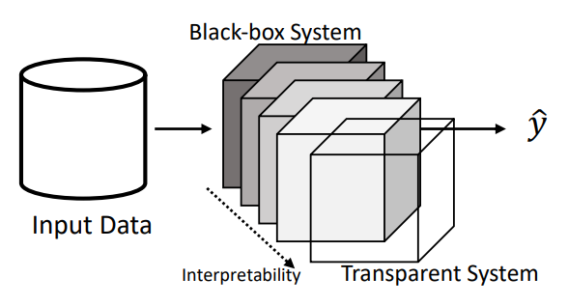
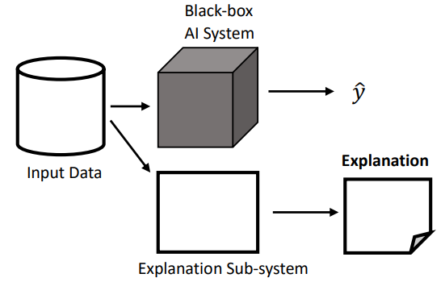
Types of interpretability
Intrinsical, Post-hoc, or Active
Intrinsical interpretability means that the model can be explained directly, usually for simple models, such as single-layer perceptron.
Post-hoc (Passive) interpretability refers to the use of various interpretation methods after model training, independent of the model.
Active interpretability refers to actively change the network architecture or training process for better interpretability.

Slide 14
Types of interpretability
2. According to output of interpretation method
Examples
Provide example(s) which may be considered similar or as prototype(s)
Attributions
Assign credit (or blame) to the input features (e.g. feature importance, saliency masks)
Hidden semantics
Make sense of certain hidden neurons/layers
Rules
Approximate the black box model with an interpretable model, such as decision trees, rule sets and other rule formats.
For example, you can directly use various decision tree learning algorithms, such as CART and C4.5, to fit the input and output of a network

Slide 15
Types of interpretability
3. Model specific or model independent
Model Specific
For example, feature map visualization can only be used for neural network models;
Model independent
The relationship analysis of input and output can be applied to almost all prediction models. The method of using feature dimensionality reduction, principal component analysis and other technologies to study the input and output of neural networks belongs to model independent interpretation technology, and students can learn by themselves.

Slide 16
Types of interpretability
4. Local or Global
Local
Explain network’s predictions on individual samples (e.g. a saliency mask for an input image)
Semi-Local
In between, for example, explain a group of similar inputs together
Global
Explain the network as a whole (e.g. a set of rules/a decision tree)

Slide 17
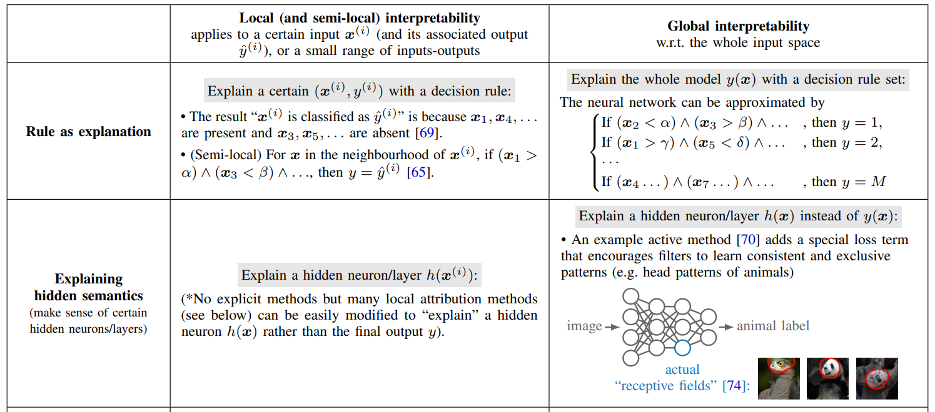
Taxonomy
Zhang et al., A Survey on Neural Network Interpretability

Slide 18
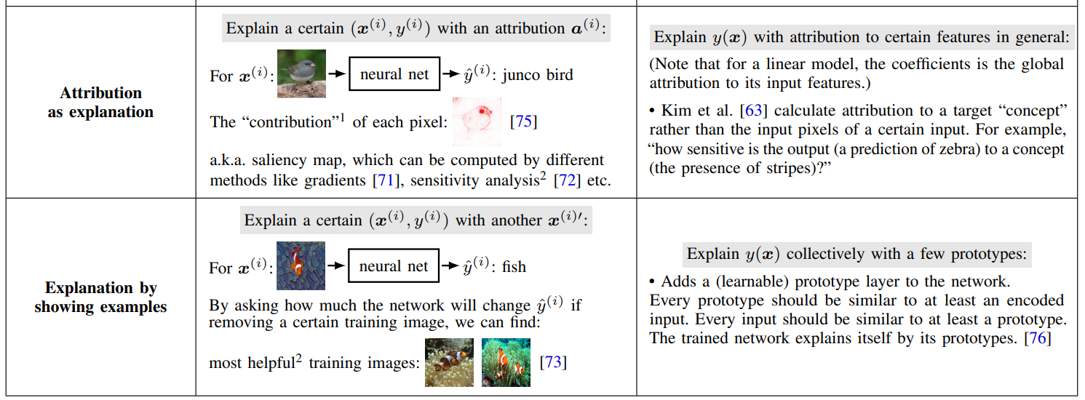
Taxonomy

Slide 19
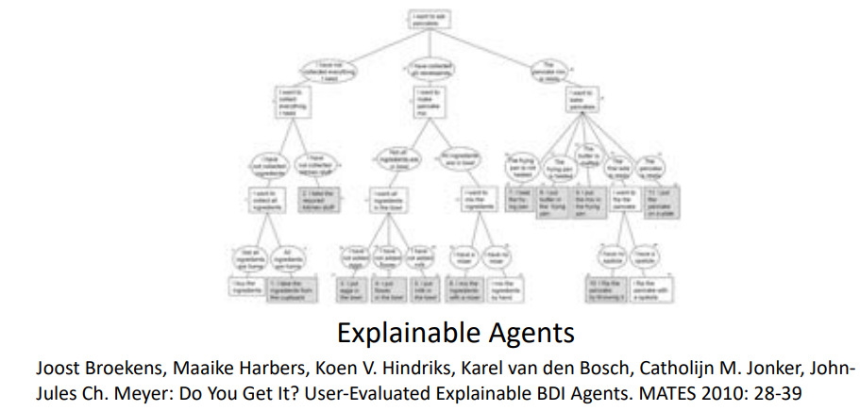
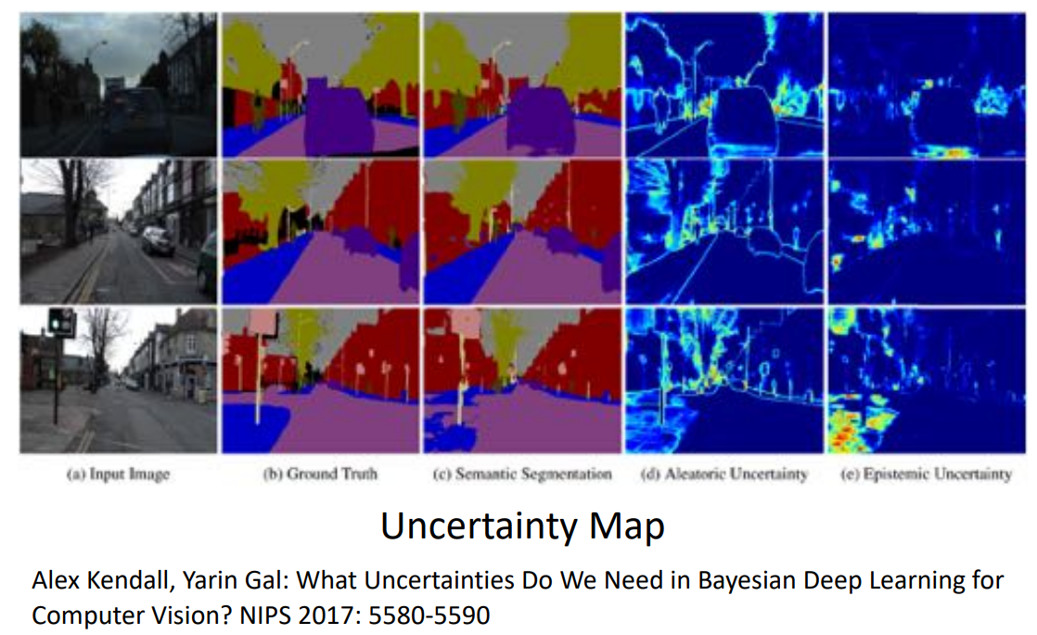
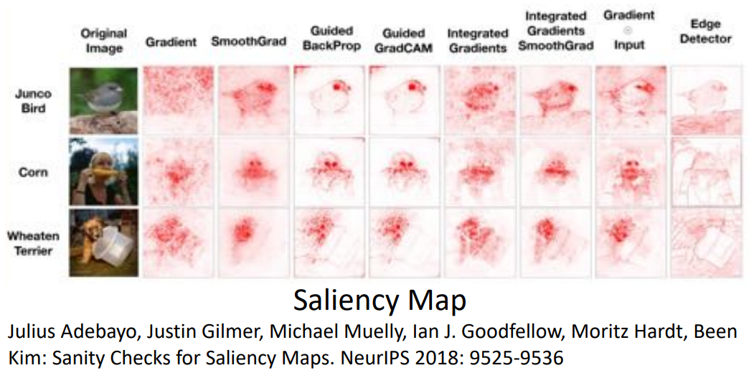
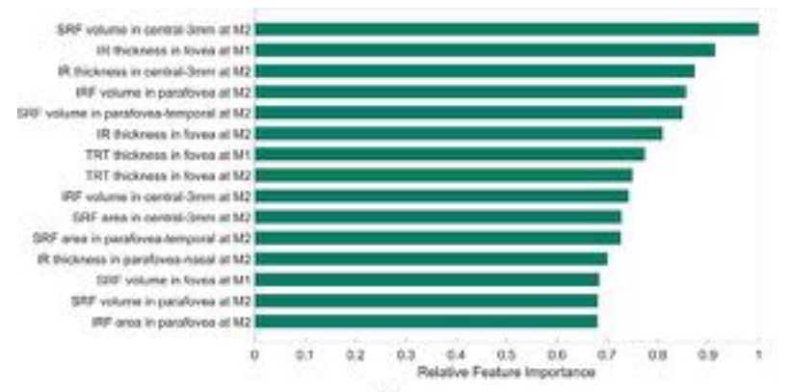
Examples

Slide 20
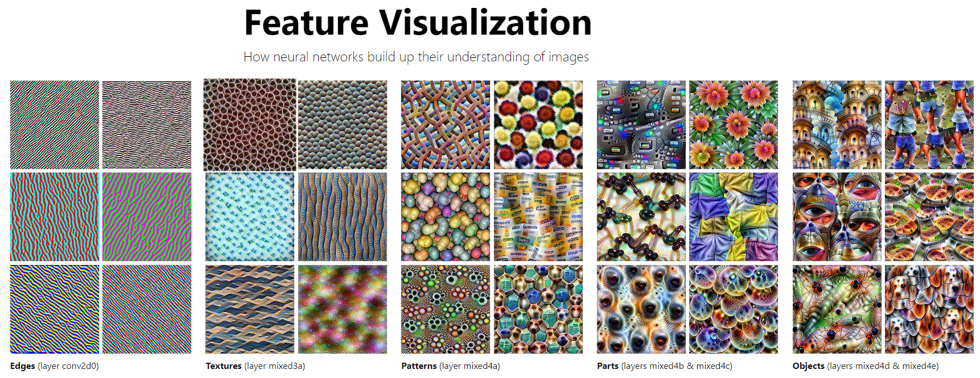
Examples
Feature Visualization (distill.pub)

Slide 21
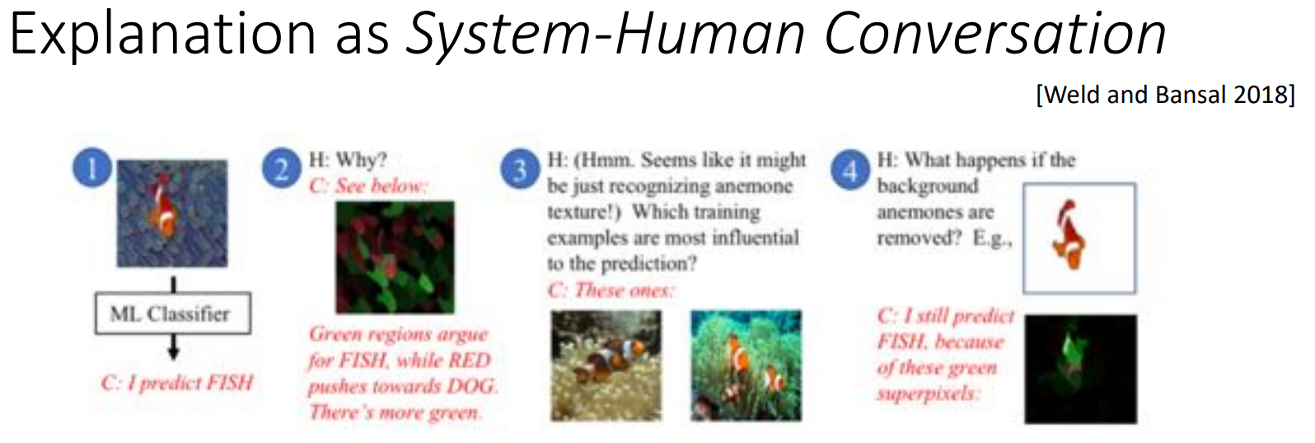
Examples

Slide 22
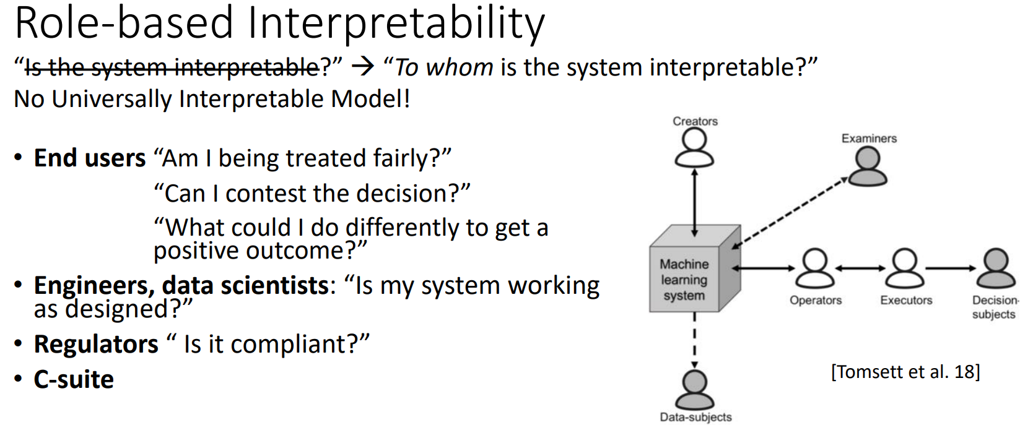
Examples

Slide 23
How to evaluate interpretability?

Slide 24
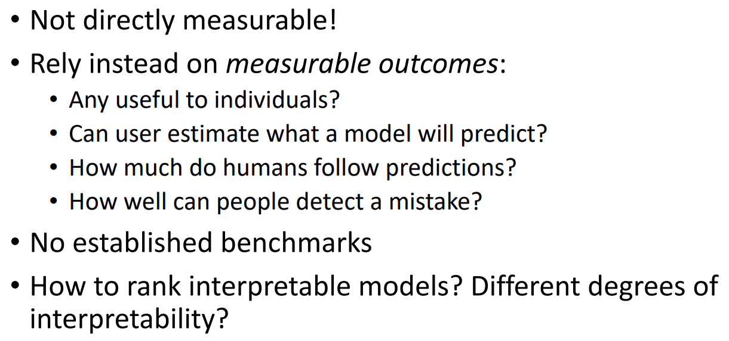
Interpretability as Latent Property

Slide 25
What is a good explanation?
1. Contrast of interpretation
A good explanation is to emphasize the difference between the research object and the reference object. Because people do not expect to have a complete explanation of the prediction but hope to compare it with another different example. For example, the explanation of drug ineffectiveness: compared with the patients who do not work, the patients who do not work do not express a certain gene, so the drug does not work. If contrast is not used, the interpretation of this may be complex.
2. Selectivity of interpretation
In fact, people do not expect to explain all the reasons that affect things but choose one or two reasons to explain. For example, the effectiveness of a new model may be the result of many factors, but we often attribute the effect to the most important improvement points.
3. The focus of interpretation is anomaly
Autonomous vehicles can run normally under 90% of working conditions, but there are a few accidents, and we should pay attention to the causes of these accidents.

Slide 26
Desired Properties of Interpretation
Informativeness
Low cognitive load
Usability
Fidelity
Robustness
Non-misleading
Interactivity /Conversational
Algorithm Complexity

Slide 27
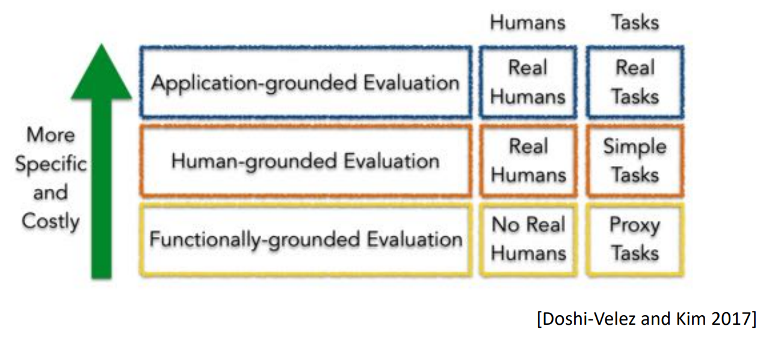
Evaluation Approaches
Application: to what extent interpretability helps the end-task (e.g., better identification of errors or less discrimination)
Human: directly letting people evaluate the quality of explanations with human-subject experiments (e.g., let a user choose which explanation is of the highest quality among several explanations)
Functionally: uses some formal definition of interpretability as a proxy for explanation quality (e.g., sparsity).

Slide 28
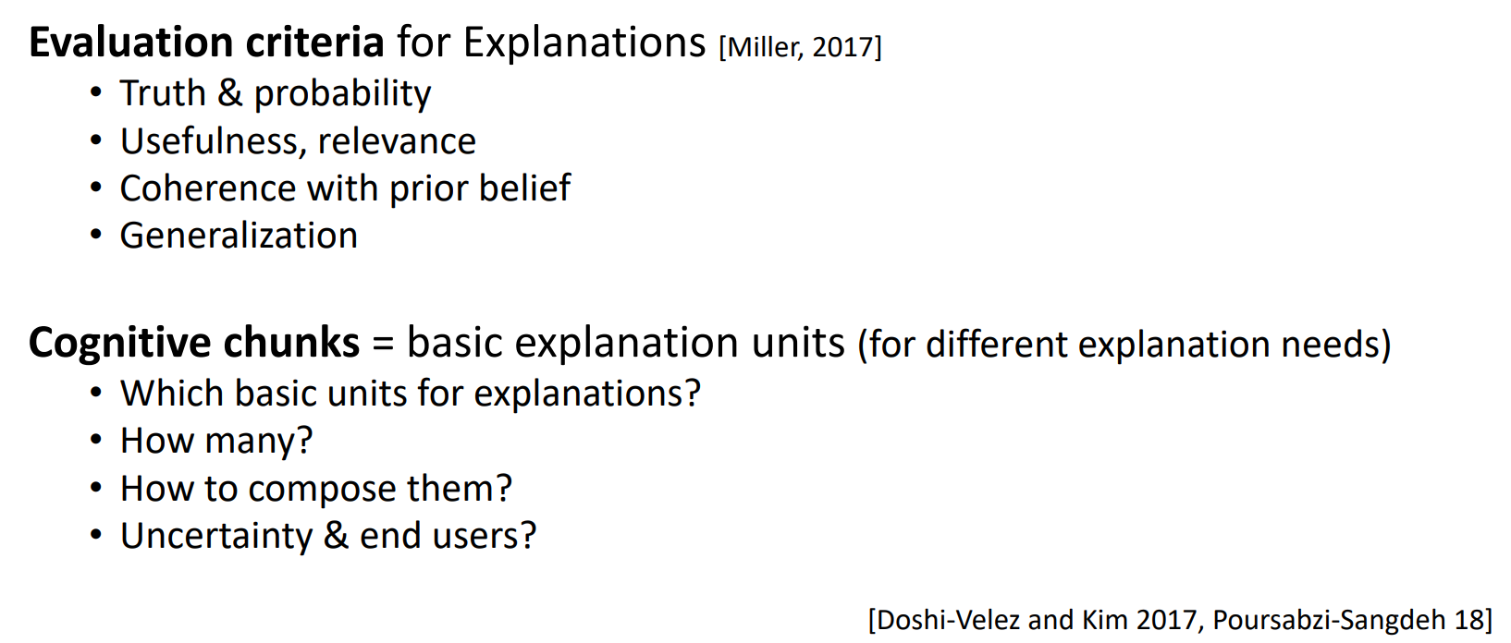
Human-based Evaluation is Essential

Slide 29
Example: Evaluation for Rules
For logic rules and decision trees, the size of the extracted rule model is often used as a criterion
e.g., the number of rules, the number of antecedents per rule, the depth of the decision tree, etc.
Strictly speaking, these criteria measure more about whether the explanations are efficiently interpretable.

Slide 30
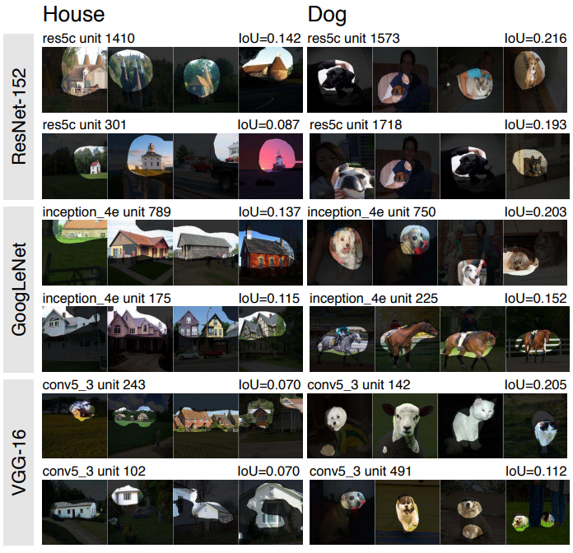
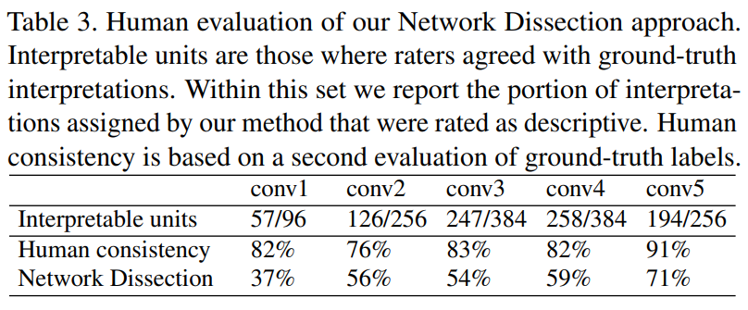
Example: Evaluation for Hidden Semantics
Measure the agreement degree between human and machine interpretation
Bau et al., Network Dissection, CVPR

Slide 31
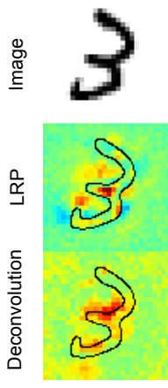
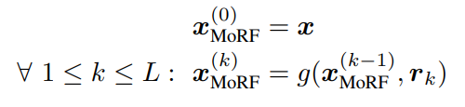
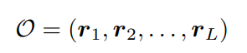
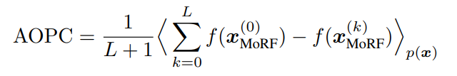
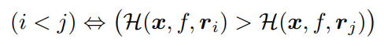
Example: Evaluation for Attribution
Region Perturbation: a greedy iterative procedure that consists of measuring how the class encoded in the image (e.g. as measured by the function f) disappears when we progressively remove information from the image x at the specified locations.
SAMEK ET AL. − EVALUATING THE VISUALIZATION OF WHAT A DEEP NEURAL NETWORK HAS LEARNED, ArXiv 2015

Slide 32
Interpretability Methods for DNN

Slide 33
Rule as Explanation

Slide 34
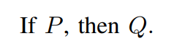
Logical Rules

Slide 35
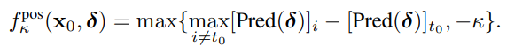
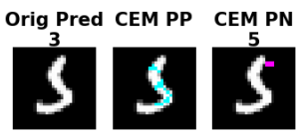
Contrastive Explanation Method (CEM)
Construct local rule explanations by finding out features that should be minimally and sufficiently present and features that should be minimally and necessarily absent.
Finding Pertinent Positives (PP):
Finding Pertinent Negatives (PN):
“The row 1 digit is a 3 because the cyan pixels (shown in column 2) are present and the pink pixels (shown in column 3) are absent”.
Dhurandhar et al., Explanations based on the Missing: Towards Contrastive Explanations with Pertinent Negatives, NeurIPS 2018

Slide 36
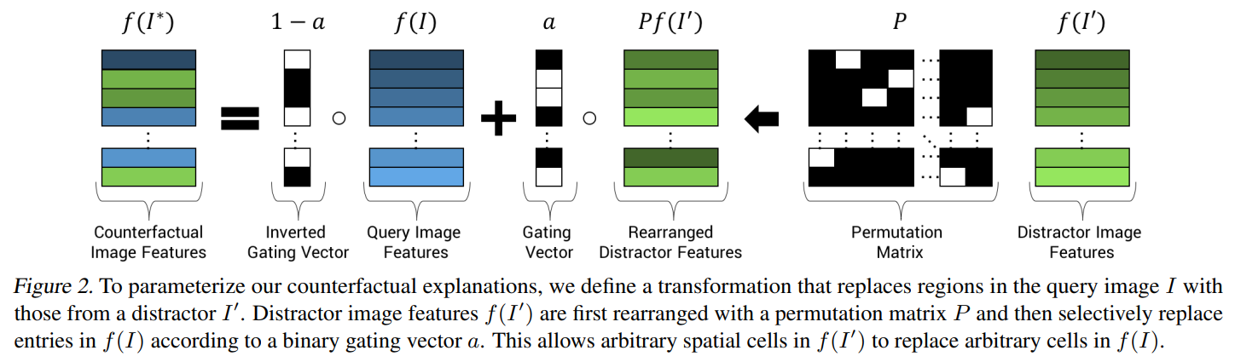
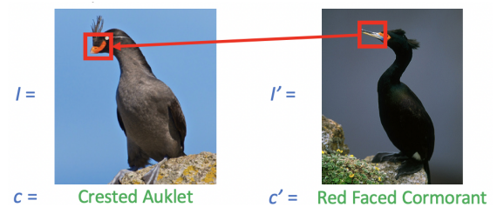
Counterfactual Visual Explanations
find the minimum-edit on an input image which can result in a different predicted class
“What region in the input image makes the prediction to be class c, rather than c’”
Goyal et al., Counterfactual Visual Explanations, ICML 2019

Slide 37
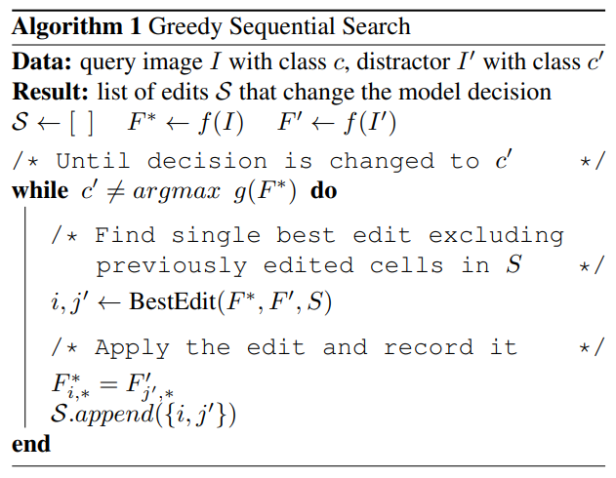
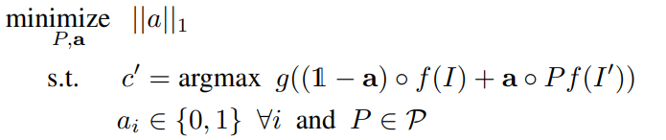
Counterfactual Visual Explanations
find the minimum-edit on an input image which can result in a different predicted class

Slide 38
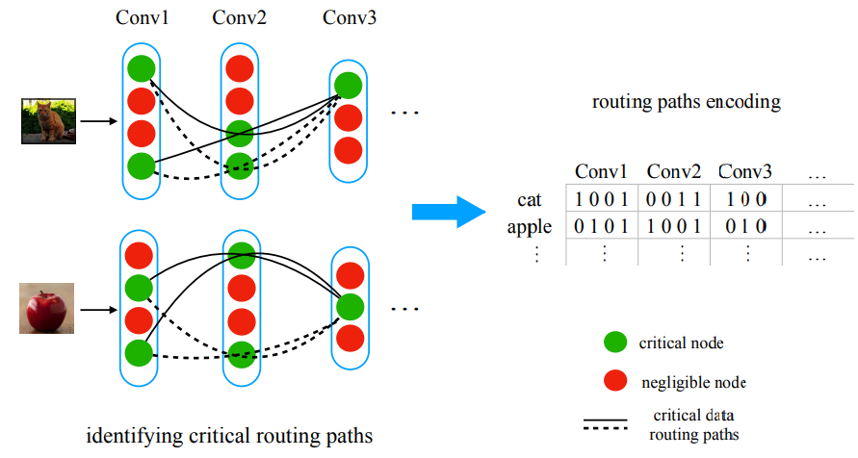
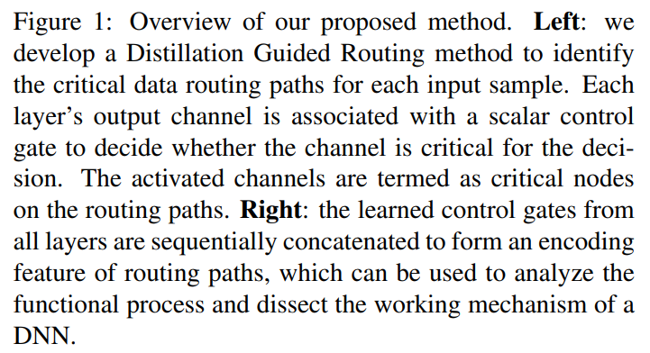
Critical Data Routing Paths (CDPRs)
Associated every output channel on each layer with a gate (non-negative weight), which indicates how critical that channel is.
CDRPs can then be identified for each input by first identifying the critical nodes, assign meanings to the critical nodes so that the critical paths become local explanations
Wang et al., Interpret Neural Networks by Identifying Critical Data Routing Paths, CVPR

Slide 39
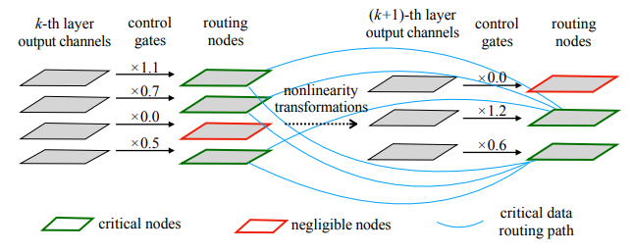
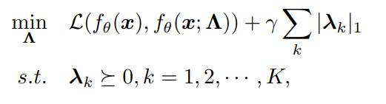
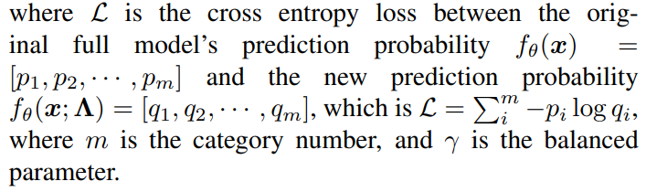
Critical Data Routing Paths (CDPRs)
Distillation Guided Routing: distilling the subnetwork outlined by routing paths without which the performance degenerates severely.

Slide 40
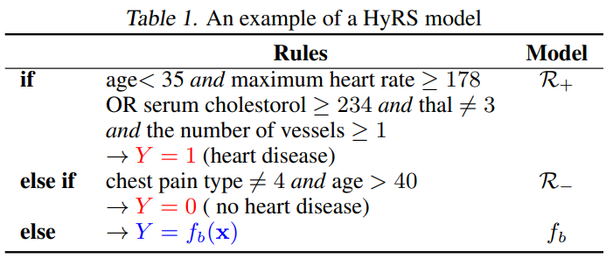
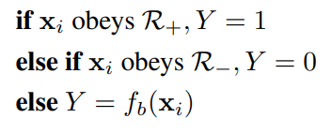
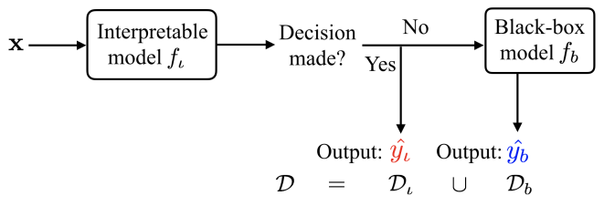
Wang, Gaining Free or Low-Cost Transparency with Interpretable Partial Substitute, ICML 2019
Hybrid Rule Sets (HyRS)
Attempted to find an interpretable partial substitution (a rule set) to the network that covers a certain subset of the input space.

Slide 41
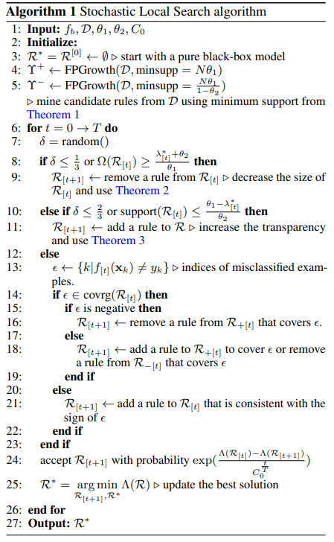
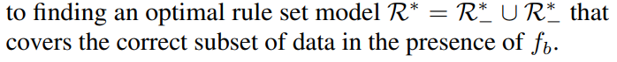
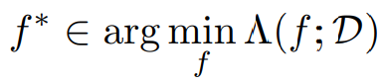
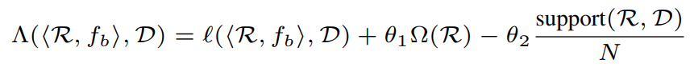
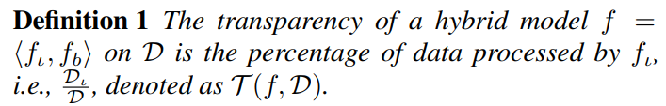
Hybrid Rule Sets (HyRS)
Model Training
error
Interpretability
Transparency

Slide 42
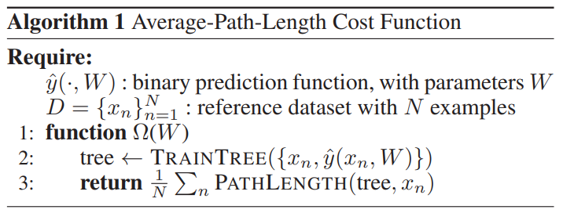
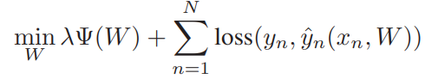
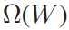
Tree Regularization for Deep Models
Attempts to penalize models whose predictions are not easily simulatable.
Step1. find a single binary decision tree which accurately reproduces the network’s thresholded binary predictions yˆn given input xn.
Step2. measure the complexity of this decision tree as the output of Ω(W): the average number of decision nodes that must be touched to make a prediction for an input example xn
Complexity of the decision tree
Wu et al., Beyond Sparsity: Tree Regularization of Deep Models for Interpretability, AAAI 2018

Slide 43

Tree Regularization for Deep Models
Making the Decision-Tree Loss Differentiable.
introducing and training a surrogate regularization function Ω( ˆ W) : supp(W) → R+ to map each candidate neural model parameter vector W to an estimate of the average-path-length
implemented as a standalone multi-layer perceptron network
ξ: the parameters of the MLP approximator

Slide 44




Tree Regularization for Deep Models:
2D Parabola task

Slide 45

Tree Regularization for Deep Models:
Toy Signal-and-Noise HMM Task

Slide 46
Hidden Semantics as Explanation

Slide 47

Main Idea
To find out the meaning of hidden neurons or layers.
It is driven by a desire to associate abstract concepts with the activation of some hidden neurons.
Similar to the grandmother cell hypothesis in neuroscience.

Slide 48

Activation Maximization
Look for input patterns of bounded norm which maximize the activation of a given hidden unit.
A pattern to which the unit is responding maximally could be a good first-order representation of what a unit is doing.
θ denote our neural network parameters;
hij (θ, x) be the activation of a given unit i from a given layer j in the network
Erhan et al., Visualizing Higher-Layer Features of a Deep Network, 2009

Slide 49








Activation Maximization
Example: Feature Visualization of Deep Blief Network (DBN).
to characterize hij
the distribution concentrates at x +

Slide 50



Deep Generator Network Based Activation Maximization
harness the image generator networks as priors to produce synthetic preferred images
Generated Image
Code
activation of the target neuron h
Nguyen et al., Synthesizing the preferred inputs for neurons in neural networks via deep generator networks, NIPS 2016

Slide 51



Network Dissection
Quantifies the interpretability of hidden units in terms of alignment with a set of human-interpretable concepts
Broadly and Densely Labeled Dataset
Bau et al., Network Dissection, CVPR

Slide 52


measure the alignment of each hidden unit of the CNN with each concept by evaluating the feature activation of each individual unit as a segmentation model for each concept

Slide 53



Fong and Vedaldi, Net2Vec: Quantifying and Explaining how Concepts are Encoded by Filters in Deep Neural Networks, CVPR
Net2Vec
Investigate the embeddings of concepts over multiple kernels by constructing M with a combination of several kernels.
Multiple kernels are usually required to encode one concept and kernel embeddings are better representations of the concepts.
Concept Segmentation by Filter Combinations
to minimize a per-pixel binary cross entropy loss weighted by the mean concept size
recording filter activations of a pre-trained network when probed by inputs from a reference
learning how to weight the collected probe activations to perform various semantic tasks

Slide 54



Correlation Analysis
Linguistic Correlation Analysis :Extract neuron activations from a trained model, train a classifier and use weights of the classifier to extract salient neurons.
X：the input word embeddings
Z：the hidden states
l ：property
analyzing neurons given a certain property
Dalvi et al., What Is One Grain of Sand in the Desert?, AAAI 2019

Slide 55

Correlation Analysis
Cross-model Correlation Analysis: identify neurons salient to the model M independent of any property.
Mij is the j-th neuron in the i-th model
ρ(Mij , Mi 0j 0 ) is the Pearson correlation coefficient.
Identify neurons salient to the model M independent of any property
Salient neurons contain important information about the task and are shared across several models.
Train multiple models M1, . . . , MN for the same task, using identical model settings but with differing training data and initialization.
Dalvi et al., What Is One Grain of Sand in the Desert?, AAAI 2019

Slide 56

Zhang et al., Interpretable Convolutional Neural Networks, CVPR
Interpretable CNN
Given a target conv-layer of a CNN, we expect each filter in the conv-layer to be activated by a certain object part of a certain category, while remain inactivated on images of other categories

Slide 57

Zhang et al., Interpretable Convolutional Neural Networks, CVPR
Interpretable CNN
Add the loss for the output feature map of each filter：
1) each filter must encode a distinct object part that is exclusively contained by a single object category,
2) the filter must be activated by a single part of the object, rather than repetitively appear on different object regions.

Slide 58


Interpretable CNN
During the forward propagation
- Estimates the potential position of the object part on the feature map x as the neural unit with the strongest activation.
- Based on the estimated part position µˆ, the CNN assigns a specific mask with x to filter out noisy activations.
- Each template Tµi matches to a feature map x when the target part mainly triggers the i-th unit in x.
Templates of Tµi

Slide 59



Interpretable CNN
During the back-propagation process, our loss pushes filter f to represent a specific object part of the category c and keep silent on images of other categories.
minus mutual information between X and T
The fitness between a feature map x and a template T
Task Loss

Slide 60

Interpretable CNN
Assign the filter f with the category cˆ whose images activate f the most

Slide 61
Attribution as Explanation
To assign credit or blame to the input features in terms of their impact on the output (prediction). The explanation will be a real-valued vector which indicates feature importance with the sign and amplitude of the scores.

Slide 62

Gradient based methods
The gradients can also be computed with respect to a certain output class, for example, along which “direction” a perturbation will make an input more/less likely predicted as a cat/dog.

Slide 63

Guided backpropagation
Springenberg et al., STRIVING FOR SIMPLICITY:
THE ALL CONVOLUTIONAL NET, ICLR 2015
A single neuron is left non-zero in the high level feature map.
Then the resulting reconstructed image shows the part of the input image that is most strongly activating this neuron (and hence the part that is most discriminative to it).

Slide 64




Guided backpropagation
adds an additional guidance signal from the higher layers to usual backpropagation.
This prevents backward flow of negative gradients, corresponding to the neurons which decrease the activation of the higher layer unit we aim to visualize.

Slide 65


Guided backpropagation

Slide 66

Guided backpropagation
replace the stride in the network by 2 × 2 max-pooling after training, which allows us to obtain the values of switches.

Slide 67

Guided Grad-CAM (Class Activation Mapping)

Slide 68

Guided Grad-CAM
Selvaraju et al., Grad-CAM: Visual Explanations from Deep Networks via Gradient-based Localization, ICCV

Slide 69


Guided Grad-CAM
Neuron importance weights:
represents a partial linearization of the deep network downstream from A, and captures the ‘importance’ of feature map k for a target class c
only interested in the features that have a positive influence on the class of interest, i.e. pixels whose intensity should be increased in order to increase y c

Slide 70

LIME (Local Interpretable Model-agnostic Explanations)
LIME, an algorithm that can explain the predictions of any classifier or regressor in a faithful way, by approximating it locally with an interpretable model.
Interpretable
Local fidelity
Model-agnostic
Ribeiro et al., “Why Should I Trust You?”, arXiv 2016

Slide 71



LIME
Interpretable explanations need to use a representation that is understandable to humans, regardless of the actual features used by the model.
Define an explanation as a model g ∈ G, where G is a class of potentially interpretable models, such as linear models, decision trees, or falling rule lists.
Ω(g) be a measure of complexity
acts over absence/presence of the interpretable components
πx(z) as a proximity measure between an instance z to x
The bold red cross is the instance being explained. LIME samples instances, gets predictions using f, and weighs them by the proximity to the instance being explained (represented here by size). The dashed line is the learned explanation that is locally (but not globally) faithful.

Slide 72


LIME
highlight the super-pixels with positive weight towards a specific class

Slide 73


LIME
SP-LIME, a method that selects a set of representative instances with explanations to address the “trusting the model” problem, via submodular optimization.
The features that explain many different instances have higher importance scores.

Slide 74



ExpO
Plumb et al., Regularizing Black-box Models for Improved Interpretability, NeurIPS 2020
Define regularizers that can be added to the loss function and used to train an arbitrary model.
To control for explanation quality without making explicit constraints on the model family in the way that by-design approaches do.
a regularizer that encourages f to be interpretable in the neighborhood of xi
or
Fidelity metric
Stability metric

Slide 75

ExpO
Approximation to Metrics:

Slide 76

DAPr (deep attribution prior)
To train a second prior model to use meta-features to predict global feature importance values.
add a penalty term to our prediction model’s loss function that encourages the values of local attributions to be similar to predicted global importance values.
Meta-feature: sets of information about each feature that characterize the feature
Weinberger and Janizek, Learning Deep Attribution Priors Based On Prior Knowledge, NeurIPS 2020

Slide 77



DAPr (deep attribution prior)
meta-feature matrix:
assigns scalar-valued penalties to the feature attributions for f with input x
• Learn a relationship between provided meta-features and feature importance for a given prediction task.
• Bias prediction models to rely more heavily on the features deemed important by this learned meta-feature to feature importance relationship.
alternating between one step of optimizing ˆf, and one step of optimizing gˆ via a gradient descent-based optimization method

Slide 78

Dual-net
Feature importance ranking (FIR) can then be formulated as follows:
Q(x,m) quantifies the instance-level performance of a learning system trained on D via a feature subset
m∗ is the indicator of an optimal feature subset discovered by an FIR algorithm
Score(m∗ ) quantifies the importance of all the selected features in this optimal subset
Wojtas and Chen, Feature Importance Ranking for Deep Learning, NeuaIPS 2020

Slide 79



Dual-net
predicting the averaging performance of the operator net on different feature subsets

Slide 80
Explanation by Example

Slide 81
Main Idea
When asked for an explanation for a new input, these approaches return other example(s) for supporting or counter example.
One basic intuition is to find examples that the model considers to be most similar (in terms of latent representations)

Slide 82



Koh and Liang, Understanding Black-box Predictions via Influence Functions, ICML 2017
via Influence Functions
To understand the effect of training points on a model’s predictions
How would the model’s predictions change if we did not have this training point?
Upweighting a training point
How would the model’s predictions change if a training input were modified?
Perturbing a training input

Slide 83





via Influence Functions
VS.

Slide 84


via Influence Functions

Slide 85


Case-Based Reasoning through Prototypes
Observations are classified based on their proximity to a prototype observation within the dataset.

Slide 86




Case-Based Reasoning through Prototypes
Loss function reflects the needs for both accuracy and interpretability.
cross-entropy loss
Li et al., Deep Learning for Case-Based Reasoning through Prototypes:
A Neural Network that Explains Its Predictions, AAAI 2018
reconstruction loss
two interpretability regularization terms

Slide 87


Case-Based Reasoning through Prototypes

Slide 88

Chen et al., This Looks Like That: Deep Learning for Interpretable Image Recognition, NeurIPS 2019
ProtoPNet (prototypical part network)
We might focus on parts of the image and compare them with prototypical parts of images from a given class.

Slide 89

ProtoPNet (prototypical part network)
Network architecture:

Slide 90

ProtoPNet (prototypical part network)
Training Algorithm:
1. Stochastic gradient descent (SGD) of layers before last layer:
2. Projection of prototypes:
3. Convex optimization of last layer:

Slide 91

ProtoPNet (prototypical part network)
Reasoning Process:

Slide 92
The End

